Slide 1

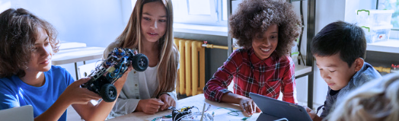
Ed71: The World’s First AI-Native National Education System
Confidential & Proprietary

Slide 2
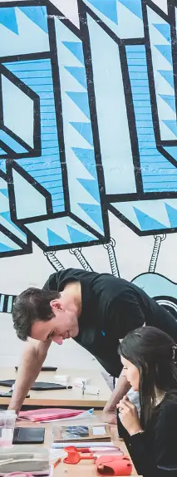

‘Educated in the Emirates’ as a Global Credential
VISION
Only AI-native education system, purposefully designed for national scale
Commitments to students: love school , learn 2x faster, life skills for the AI age
Creating the next generation of global leaders through life skills and academic mastery
The “Stanford of K-12 Education”
Our mission: Ed71 is the AI-native public education system for all Emiratis

Slide 3


A video like this, filmed in any Emirati public school
THE STUDENT EXPERIENCE

Slide 4


We have reinvented the school day
THE KEY TO SUCCESS
Core truths of transformation
Traditional
Alpha Model
Children should love school more than vacation
2 hours of academic mastery
Children can master academics in 2 hours per day
6 hours of classroom instruction
4 hours of life-skills development
The key to your children’s happiness is high standards
Timeback: the AI and learning science platform delivering academic mastery 10x faster than traditional schooling
AlphaCore: an AI-age life-skills curriculum developing student leadership, teamwork, communication, resilience, and other non-academic capabilities

Slide 5
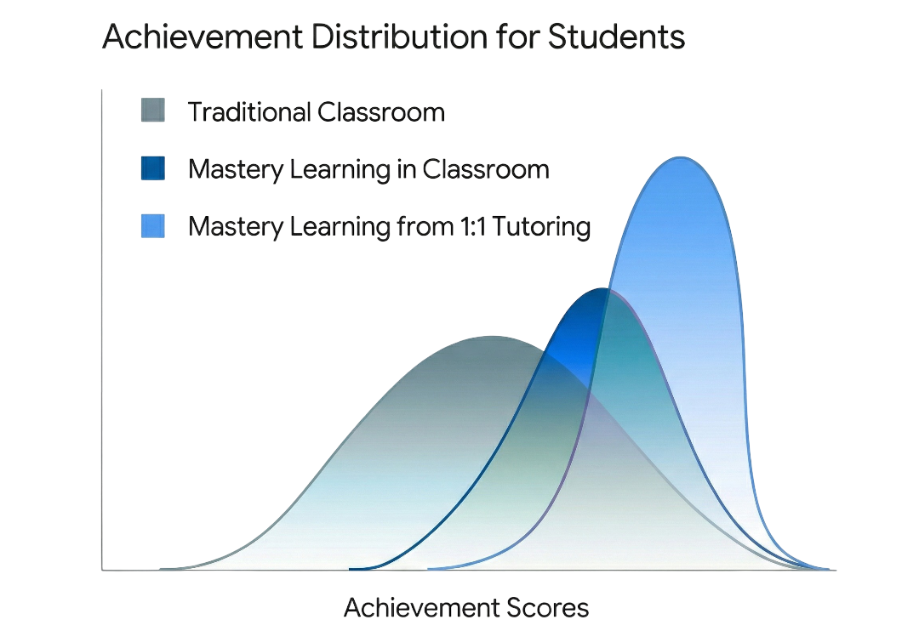
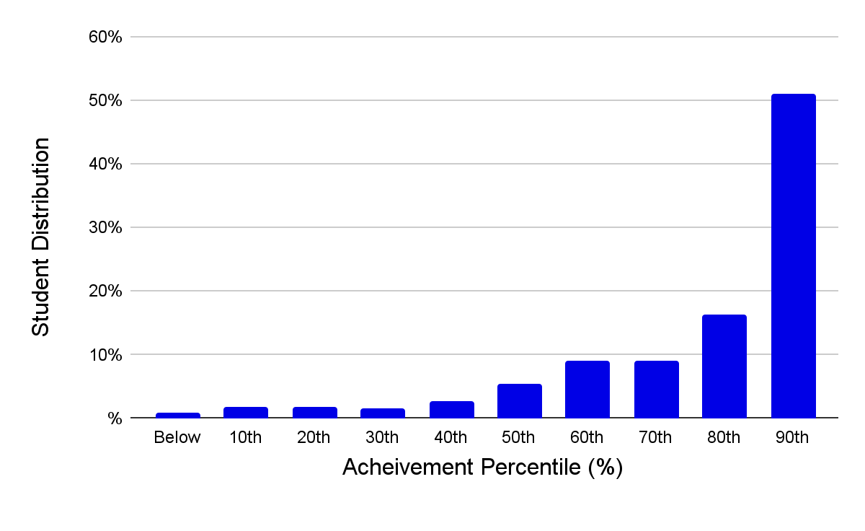





The learning science has been known for 40 years… we have made it work
97% love school
OUR RESULTS
High School students voted to keep school open over summer
Over 60% of students would rather go to school than go on vacation
80% of older students say their Guide is one of most influential people in their life
Blooms 2-Sigma Problem (1984)
Timeback Student Achievement
100+ life skills projects
All Third Graders can solve the Rubik’s cube.
Fifth Graders presented TED-style talks at NYC open mic nights
Middle Schoolers placed 2nd in the world and 1st in the U.S. in the prestigious Global AI Debates
High Schoolers traveled to Ukraine on a humanitarian mission to help kids whose schools were destroyed
Maddie created the first teen-produced Broadway musical with 67,000 TikTok followers and millions of views
Alex created “Berry," an AI-powered plush toy for teens' mental health
Sloane built "InnerWorld" app with 2.5M+ social media following, solving teen girl mental health crisis
Grace produced a documentary on cancer with 5 million views, testifying at the U.S. Senate
Exceptional Growth (vs. 1x “expected”)
World-Class College Admissions
Avg. SAT: 1530 (vs. 1063 national)
94% students with 4 or 5 on AP
Avg all students growth: | 2.2x
Top 20% growth: | 3.9x
Top ⅔ growth: | 2.6x
2 years behind growth: | 4.9x
Notes:
INDIVIDUAL MASTERPIECE PROJECTS:
Maddie created the first teen-produced Broadway musical with 67,000 TikTok followers and millions of views
Kate wrote a newsletter with 16,000 Substack subscribers and 33,000 X followers
Alex created “Berry," an AI-powered plush toy for teens' mental health
Sloane built "InnerWorld" app with 2.5M+ social media following, solving teen girl mental health crisis
Rhett raised $3.2 million to build largest bike park in Texas
Grace produced a documentary on cancer with 5 million views, testifying at U.S. Senate
Everest (10) became first elementary-aged girl to earn a silver metal the History Bee and Bowl National Championships
GROUP WORKSHOPS & PROJECTS
High schoolers traveling to Ukraine on a humanitarian mission to help kids whose schools were destroyed
Fifth graders presenting TED-style talks at NYC open mic nights
Placed 2nd in the world and 1st in the U.S. in the prestigious Global AI Debates
AGGREGATE – maybe instead?
$6.45+ million in seed capital raised across student ventures
9 students selected as TEDx Youth speakers
10+ million combined documentary/video views
2.6+ million combined social media following across student projects
Multiple TV appearances (Fox News, Dr. Phil, national news coverage)
U.S. Senate testimony on health policy
INDIVIDUAL STUDENT PROJECTS (EXPANDED)
Maddie - Creating first teen-produced Broadway musical, 67K TikTok followers, millions of views, 2 off-Broadway performances in NYC attended by Broadway producers and investors, releasing first single on Spotify
Kate - Built education newsletter with 16K Substack subscribers and 33K X followers, helping parents bring education into the 21st century
Grace - Produced cancer documentary with 5+ million views, 66K X followers, testified at U.S. Senate, interviewed on Fox News and Dr. Phil, regularly invited to testify before state legislatures
Rhett - Raised $3.15 million to build largest bike park in Texas, competitive mountain biker who turned passion into reality through land acquisition and investor pitches
One senior - Raised $3.3 million from investors (majority from people previously unknown), built business with school support and afternoon project time
Sloane- Built 2.5M+ social media following, created "InnerWorld" app (first digital emotional headquarters) solving teen girl mental health crisis
Alex - Building "Berry," an AI-powered plush toy for teens' mental health with goal to reach 100 million people by 2035
Elle (16) - Built AI-enabled dating advice app for teenagers
Geetesh - Building "Y Combinator for teenagers," created 4-week AI and life skills curriculum for refugee camp in Malawi (100% of students reported program helped with life skills and AI literacy)
Byron (10) - Managed Airbnb property project learning finance, real estate, property management, vetting tenants, and marketing

Slide 6







Launching UAE's Ed71 on Alpha's full education stack
THE COMPLETE PLATFORM
Alpha Education Stack
Ed71: UAE Owned
Parent Education System: Parents demand outcomes |  |  | Education Sovereignty: UAE owns the critical pieces
Reinvented School Day: 2 hrs of academics + life skills |  |  | Infrastructure: Built to scale across 100+ schools
Timeback®: AI platform for 10x faster mastery |  |  | Localized AI Apps: Arabic, Islamic, Social Studies, and ESL
AlphaCoreTM: The strongest K-12 life-skills curriculum |  |  | AsasCore: Emirati life-skills system based on AlphaCore
Guide School: Talent academy for training guides |  |  | Talent Academy: Recruit and train UAE Ed71 Guides
Incept eduLLM: Personalized content generation |  |  | UAE eduLLM: Embedded UAE laws, values, and culture
This Year
3-Year Target
Next Year
5-Year Target
2,500 students
100k students
2k students
200k students
22 campuses
100 campuses
2 communities
50+ communities
$25k per student annual budget - ~2x current public funding
$1.5B up-front spend
$750m UAE asset and infrastructure development
$750m prepaid fees to Alpha (for first 100k student-years)
First schools open SY26-27 - start with 2 Abu Dhabi model schools

Slide 7
Financial

Slide 8
Ed71 Commercial & Investment Structure
PUBLICLY FUNDED, PRIVATELY OPERATED SCHOOLS
Commercial Structure
Investments (Optional)
Upfront
Investment | Amount | Val. | Timing
Incept Labs (eduLLM) | $1B | $10B | 2026
optional $250M directed development fee for UAE-specific customizations (language, laws, customs, culture, values)
Alpha Holdings (2026 round) | $100M | $10B | 2026
Alpha Holdings (2027 round) | $1B | $100B | 2027
TimeBack edu video game | $20M | $1B | Dec 2025
Total | $2.12B | (plus optional $250M directed development fee)
Item | Upfront | Recipient
AlphaCore License | $250M | Alpha Holdings
UAE EdTech App R&D | $250M | Local expense
AsasCore R&D | $250M | Local expense
Management Fee Prepay | $250M | Prepaid Opex for 100k student-years
TimeBack License Fee Prepay | $500M | Prepaid Opex for 100k student-years
Total Ed71 Schools | $1.5B
Ongoing
Item | Ongoing | Recipient
Parent Edu / Launch / Guides | $25-50M / yr | Local expense
Additional School Funding | $1B / yr* | Local expense
Management Fee | 10% budget | OpEx to Alpha Holdings
TimeBack License Fee | 20% budget | OpEx to Alpha Holdings
Total Ed71 Schools | Scale dependent
* per 100k students

Slide 9
Timeback frees budget and time for life skills
TIMEBACK CREATES COST ADVANTAGES
Item (with per student P&L) | Conventional School | Timeback + Teachers | Timeback + Life Skills | Notes
FUNDING:
Tuition | $25,000 | $25,000 | $25,000 | Budget for $25,000 school
COSTS:
Guides | $13,750 | $2,500 | $4,500 | Timeback alone allows lower ratios with less specialized guides. Life skills requires a higher caliber guide.
Timeback / Software | $0 | $5,000 | $5,000 | Timeback fee 20% of Tuition
Programs and Life Skills | $0 | $0 | $4,250 | Timeback leverage allows spend on Life Skills programming
Current | $13,750 | $7,500 | $13,750
Education Outcome | Current Baseline | As Good or Better | World Class

Slide 10
Budget like other $25k Alpha Holding Schools
ED71 SCHOOL COST STRUCTURE
Item (with per student P&L) | Alpha @ $50k Tuition | AH / Ed71 @ $25k Budget | Notes
FUNDING:
Tuition / Budget | $50,000 | $25,000
COSTS:
Guides | $14,000 | $4,500 | Alpha 11:1 ratio & higher comp, AH/Ed71 25:1 ratio & lower comp | Cost to Educate Conventional schools have the same cost to educate, but with close to 100% of spend on teachers Timeback and Life Skills spend same as at gt.school and Texas Sports Academy
Timeback / Software | $10,000 | $5,000 | 20% of Budget
Programs and Life Skills | $9,000 | $4,250 | Alpha is 2x other AH/Ed71
Other HC | $1,750 | $1,750 | -
Facility / CapEx | $8,750 | $3,000 | Includes depreciated capex to convert locations to Timeback school layout and design
Misc Expense (computer, etc.) | $1,500 | $1,500 | -
Management Fee | - | $2,500 | 10% of Budget
Ed71 IP Amortization |  | $2,072 | Full amortization of IP costs over 5 year target student count of ~362,000

